Slide 1
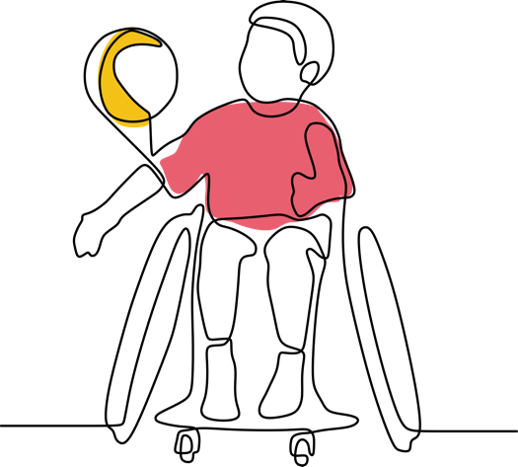


Childhood Disability, Impairment, and Chronic Pain
Critical Intersections
Gail Teachman (Presenter) & Katie Mah

Slide 2
Exploring the complex interplay between disability, impairment, and chronic pain:
Co-producing knowledge with children
Dr. Gail Teachman
Dr. Katie Mah
Dr. Fiona Webster
Trainees: Linda Zhang; Agnes Mathew

Slide 3
Chronic pain | Pain that persists or recurs and lasts longer than 3 months (Treede et al., 2015)
Disabled child/children | Acknowledging language debates, we align with critical disability studies (CDS) scholarship in using identity-first (instead of person-first) terminology to foreground the ways disability is socially produced (Curran & Runswick-Cole, 2013). Child denotes minor persons under 18 years.

Slide 4
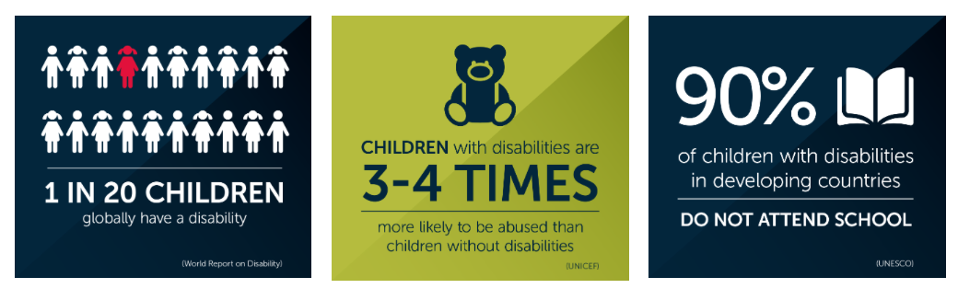
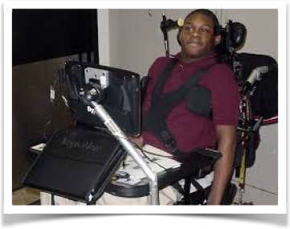
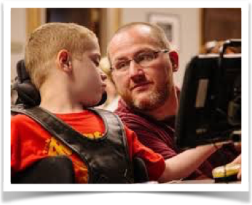
Children and youth with complex impairments, especially those with communication impairments, experience social isolation that increases with age
Because they have been largely excluded from research, little is known about their everyday lives or what matters to them
To improve services, there is an urgent need to conduct more research with these children and youth
Children and youth with complex impairments, especially those with communication impairments, experience social isolation that increases with age
Because they have been largely excluded from research, little is known about their everyday lives or what matters to them
To improve services, there is an urgent need to conduct more research with these children and youth

Slide 5
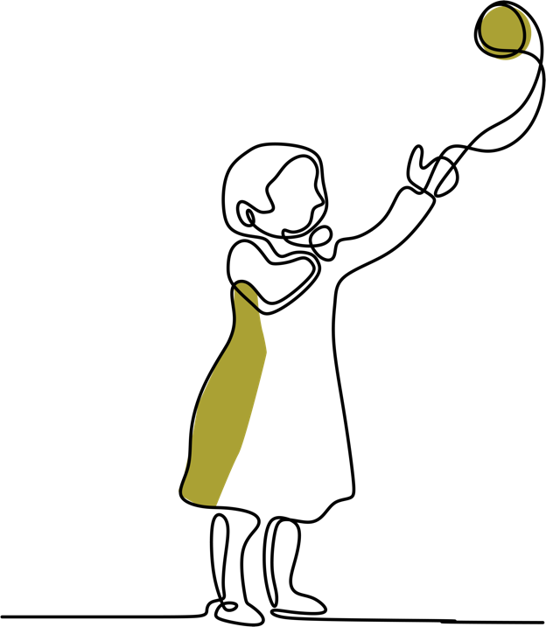
WHAT WE KNOW
Emerging understandings of how chronic pain influences children’s social connections and overall well-being
Relatively little research on childhood disability and chronic pain but we know this group experiences disproportionately higher rates of chronic pain than non-disabled peers
Chronic pain, impairment and disability are too often conflated

Slide 6
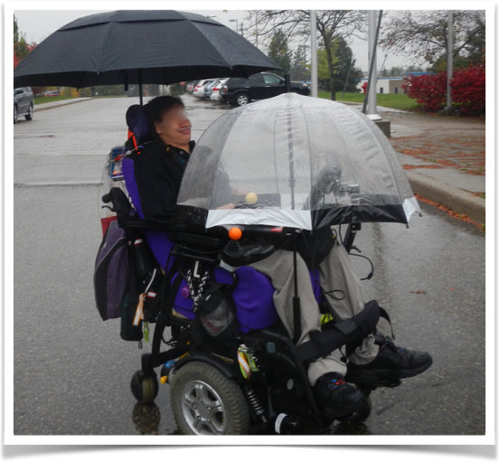
WHAT WE KNOW
My [speech-generating] device helps other people see me as a smart and whole human being
Jamila

Slide 7
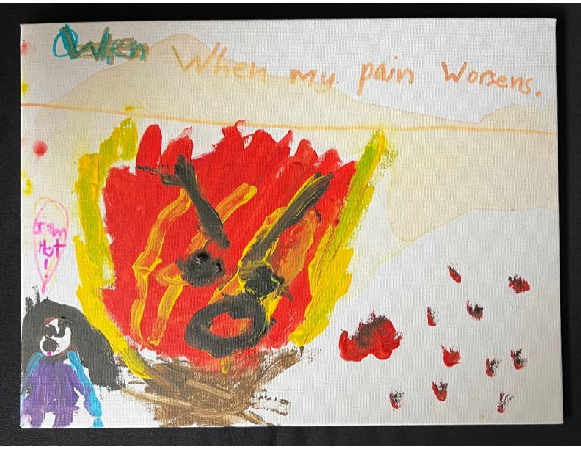
WHAT WE KNOW
Ferreira et al. (forthcoming) piloted arts-based research with young children exploring their understandings of chronic pain.

Slide 8
WHAT WE NEED TO KNOW
knowledge of disabled children’s experiences living with chronic pain
Knowledge generated in research WITH young people

Slide 9
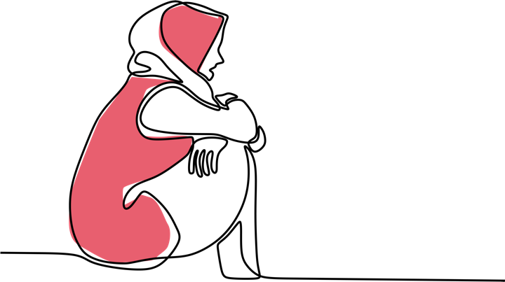
Study Methodology
Build partnerships (SKIP, CASPR, PEPR)
Recruit youth advisors
Oriented by a critical social science/critical disability studies lens
Elaborate on virtual body-map story-telling methods to optimize accessibility and flexibility
Incorporate public-facing KMb strategies e. g. digital exhibition of completed body-maps

Slide 10
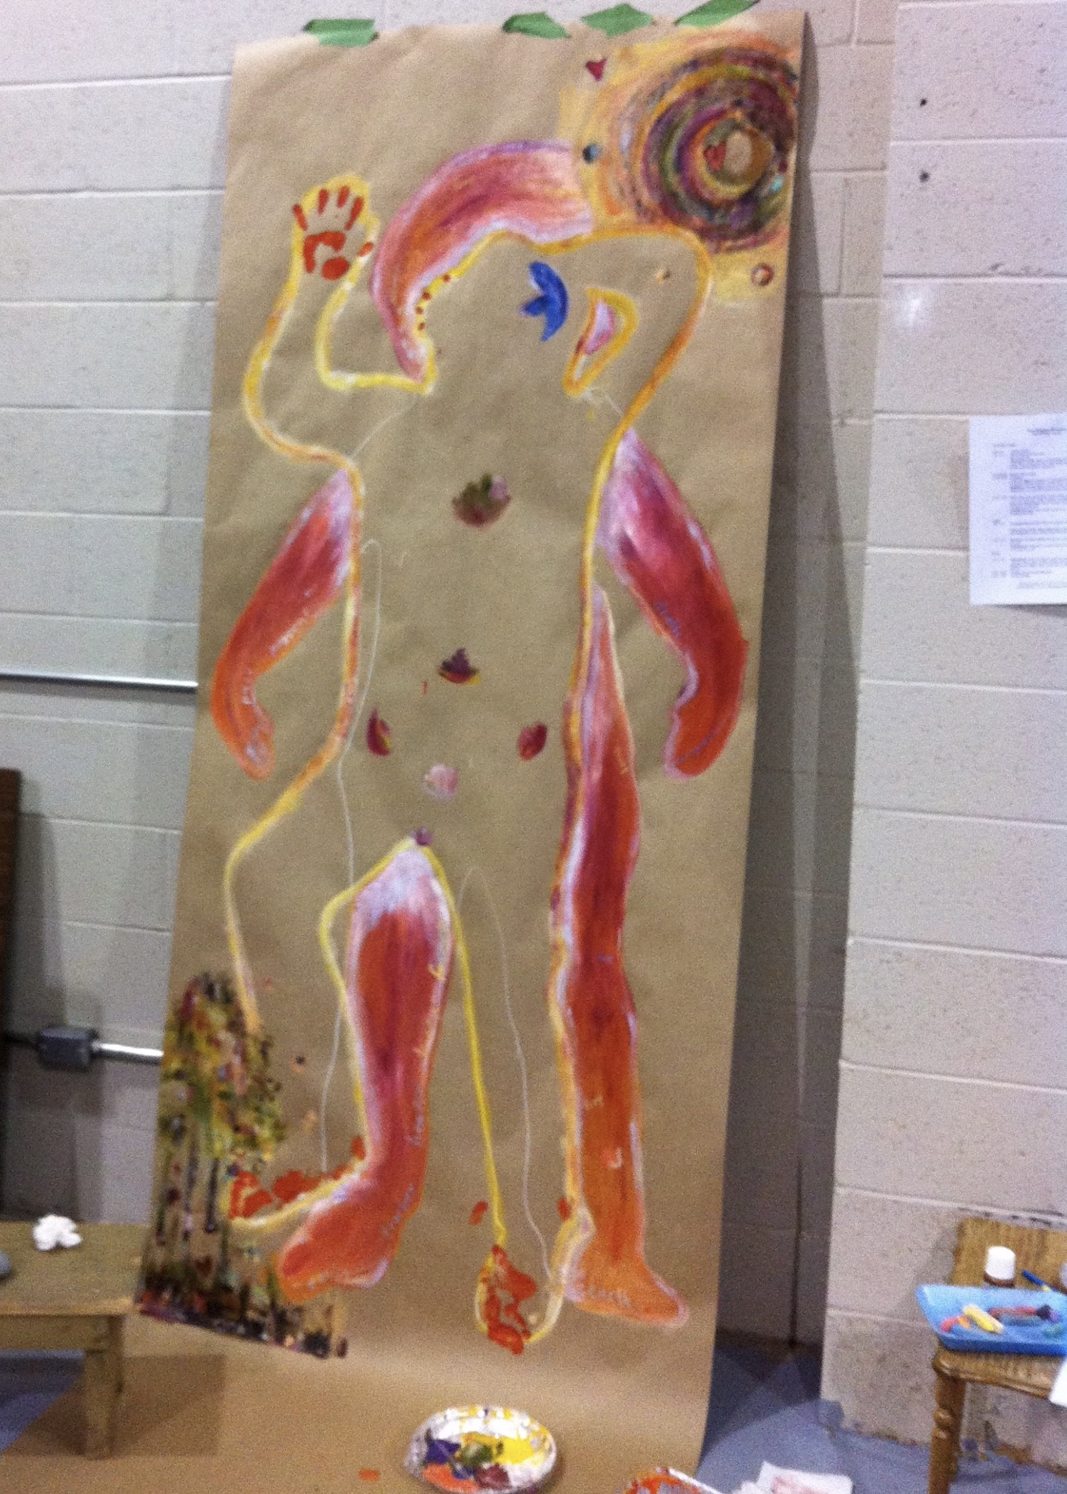
Adapted
Virtual
Body-map Storytelling Methods

Slide 11
What is disability?
What is impairment?

Slide 12
Disability as difference to be alleviated
vs.
Disability as difference that matters and exceeds accommodation

Slide 13
Disability is not a thing, it’s an idea
Different sets of ideas about disability
lead to different actions and consequences
whether we know it or not

Slide 14
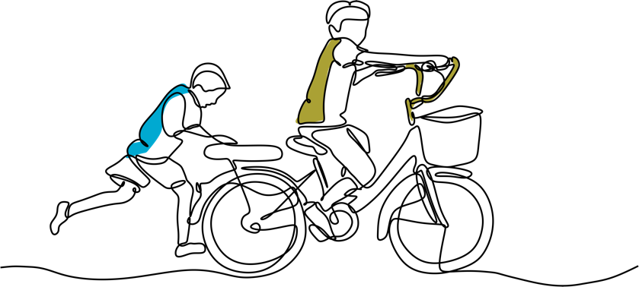
Disability has an enduring potential to get us thinking differently about the world.
Dan Goodley, Michael Miller and Katherine Runswick-Cole (2017)

Slide 15
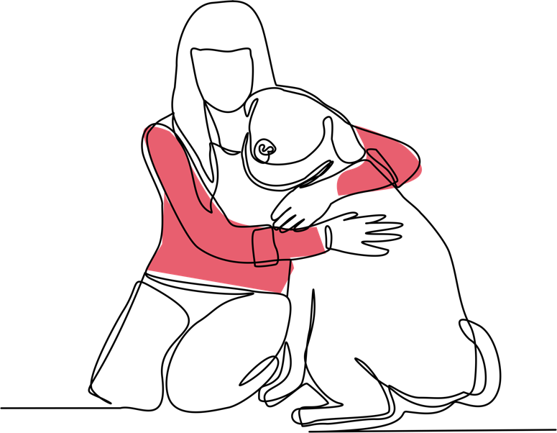
Thank You
Notes:
We look forward to sharing the results of this research.

